Slide 1


Effects of Sub-Atmospheric Pressures on the Temperature Evolution of Spark Kernels
Daniel Caplan and David Blunck, PhD.
SciTech, 8-12 January 2018
Kissimmee, Florida
GTE-07, Control ID 2795470

Slide 2
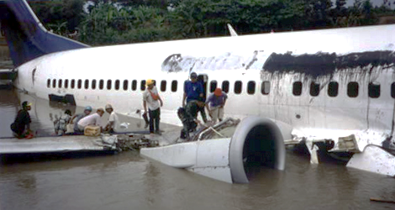
Why Study Low Pressure Spark Kernels?
Afterburner ignition
High altitude re-ignition of main combustor
Garuda Indonesia Flight GA421 wreckage after dual engine flameout induced by inclement weather in 2002. (Aviation Accidents, [5])
Notes:
So, I’m about to talk about spark kernels at low pressure, but who cares?
Afterburner ignition. If you need an afterburner during flight, you probably want it to light RIGHT NOW
Applications for mid-flight re-ignition of main combustors in case of a flameout
This plane suffered a dual-engine flame-out flying through a thunderstorm, and crashed in 2002.

Slide 3
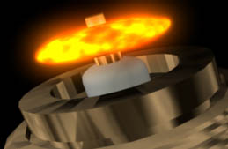
What is a Spark Kernel?
Spark Kernel
Electrodes
Illustration of a spark plug generating a spark kernel. [1]
Notes:
Small volume of gas heated by the spark

Slide 4
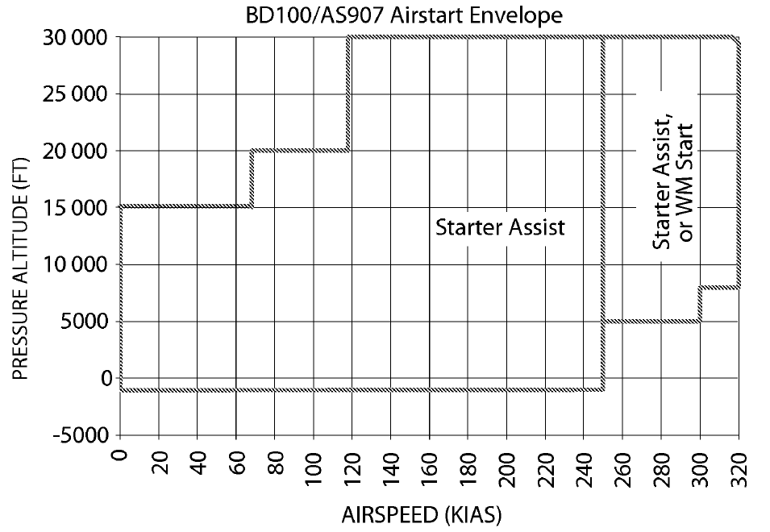
How can the Knowledge be Used?
Physics of re-light envelope
Useful for designing combustors and afterburners
Inflight re-light envelope for BD100/AS907 aircraft. [#]
Notes:
Aircraft manufacturers are required to provide an in-flight Altitude-Airspeed re-ignition envelope, like this one over here
This is determined by flight testing, and may be lower than the service ceiling of the craft
Knowledge of spark kernel behavior at low pressures can help explain the ignition altitude ceiling
This knowledge can also be used to help optimize igniter placement within the combustor

Slide 5
How is Ignition Studied?
5
Notes:
Now let me show a little of how ignition has been studied

Slide 6
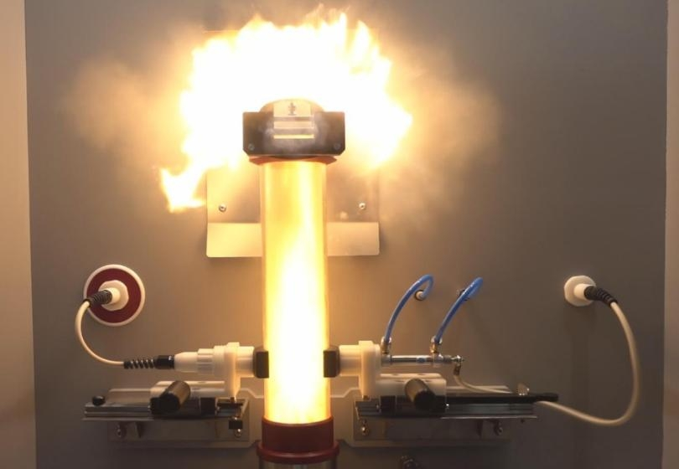
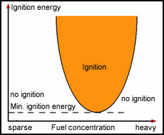
Minimum Ignition Energy (MIE)
MIE Test Rig. (Anko, [3])
MIE Graphical Representation (asdfadsf, [4])
Notes:
What: One approach is to study MIE for specific fuels. This is the minimum amount of energy input needed to ignite a combustible mixture
How: Determined by varying fuel concentration and igniter energy deposition to find the lowest ignition energy, as shown in this plot
Apparatus: This is done in an apparatus such as this commercial test chamber, which has standardized requirements
Advantages: Data is available for many fuels, including pressure dependence, and can be used to evaluate a variety of combustor configurations
Disadvantages: Provides the what but not the why: information about spark kernels can help explain why the MIE is what it is

Slide 7
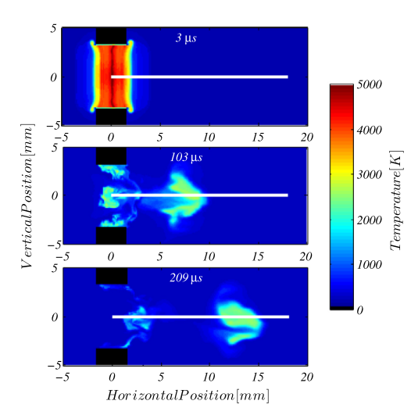
Numerical Modeling
Another Modeling Example
Modeled spark kernel in a cross flow of air. (Sforzo et al., [2])
Notes:
Another approach is numerical modeling.
For example, this is a model of a spark kernel in a cross flow of air, produced by two opposed electrodes.
Or, this model of _____________
These are great because you can calculate just about whatever you want, given the computation resources.
Models can provide valuable insights into many different things.
But, these models also need to validated by experimental results.

Slide 8
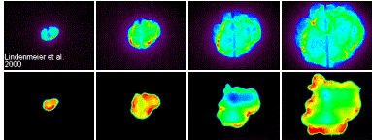
Spark Kernels: Reacting
Chemiluminescence
OH* PLIF
Chemiluminescence and OH* Planar Laser Induced Fluorescence (PLIF) images of spark ignition in a piston engine. (Karlsruhe Institute of Technology, [5])
Notes:
Spark kernels can either be reacting, or non-reacting. Reacting spark kernels, sometimes called flame kernels, can be studied using laser diagnostics or other imaging techniques.
This is an example of a reacting spark kernel in a piston engine, investigated using chemiluminescence and PLIF.
Advantages: High speed, high accuracy, flame progression, kernel-fuel interactions
Limitations: Different fuels can affect the kernels, measurement of temperature can be challenging

Slide 9
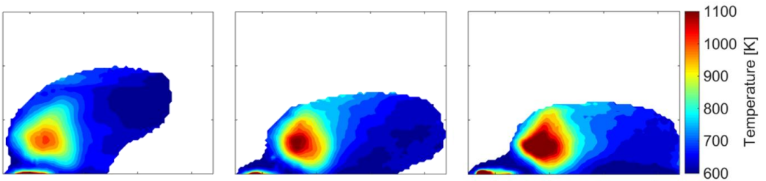
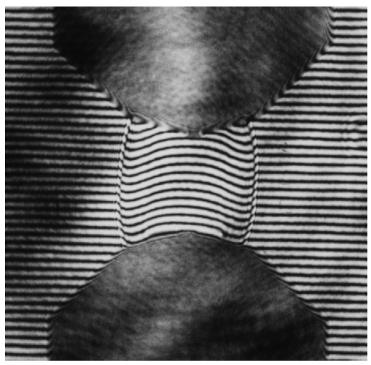
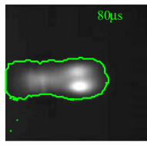
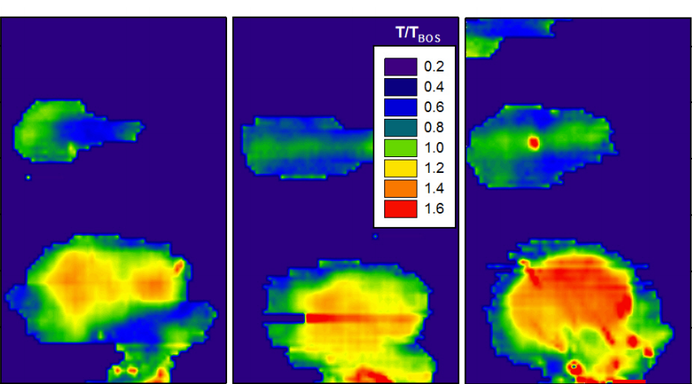
Spark Kernels: Non-Reacting
Interferogram photograph of a spark kernel shock wave in nitrogen. (Topham et al., [6])
Time resolved IR thermography temperatures of a spark kernel in a crossflow of air (Okhovat et al. [#])
Laser-Schlieren image of a spark kernel in a crossflow of air. (Sforzo et al. [2])
Time resolved IR thermography temperatures of a spark kernel in quiescent air (Blunck et al. [#])
Notes:
Non-reacting spark kernels can provide information about the behavior of a particular ignition system, independent of fuel composition.
These have been investigated using interferogram measurements, like this one, or with Schlieren imaging, like here.
The advantage of these techniques is they can provide high speed measurements, and can be used to determine a mean kernel temperature.
But, they are not able to provide spatial temperature information
An infrared thermography technique was developed by Blunck et al. which can measure spatially resolved path integrated temperatures.
This technique has been used to measure kernel temperatures in quiescent and crossflow conditions, but not at sub-atmospheric conditions.
For that matter there have not, to my knowledge, be any attempts to measure spark kernel temperatures at sub-atmospheric temperatures.
So, that is the aim of this work.

Slide 10
The Experiment
10
Notes:
Which, brings us to the experiment.

Slide 11
Goals
Spatially resolved intensities and temperatures
Effects of decreasing pressure
Possible links to ignition altitude envelope

Slide 12
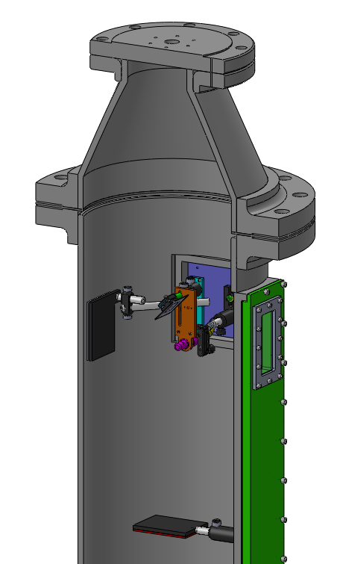
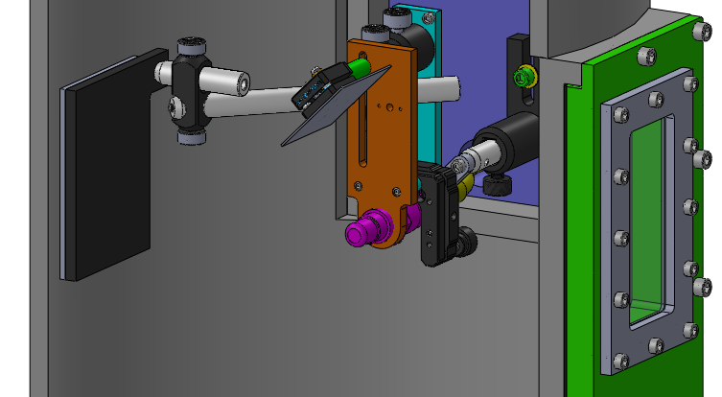
Experimental Setup
Venturi Vacuum Ejector
Mirror
Camera
Igniter
Heated Back Plate
Sapphire Window
Heated Back Plate
CAD images of igniter jig inside vacuum chamber

Slide 13
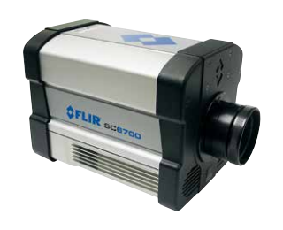
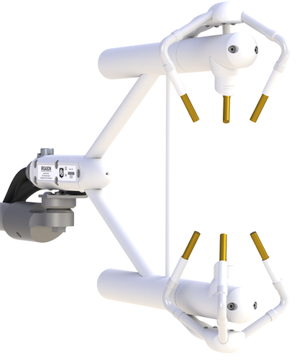
Experimental Equipment
Igniter: CH505050
Sunken fire configuration
Exciter: CH
Capacitive Exciter
Input voltage: 10-30 VDC
FLIR SC6700 IR Camera [7]
Campbell Scientific IRGASON gas analyzer [8]

Slide 14
Data Collection
Camera: FLIR SC6700
MWIR InSb Detector, 1-5 μm
Blackbody calibrated
~1500 Hz
Gas Analyzer: IRGASON
H2O and CO2 concentrations
Ambient Temperature and Pressure
FLIR SC6700 IR Camera [7]
Campbell Scientific IRGASON gas analyzer [8]

Slide 15
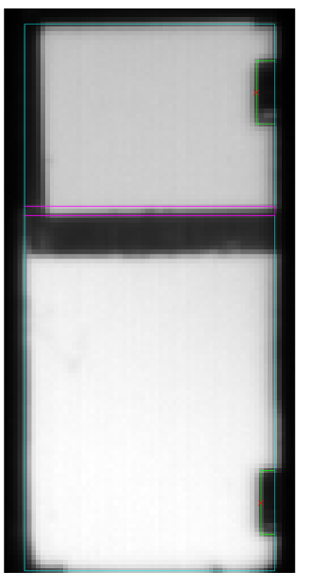
Experimental Setup
Photo of chamber with igniter inside

Slide 16

Deconvolution Technique
Radiation transfer equation for a participating medium:
Spectral Intensity
Incident Radiation
Emitted Radiation
( )
Composition
Path Length
Temperature
Pressure
Solve for temperature, measuring everything else
Intensity = function of

Slide 17
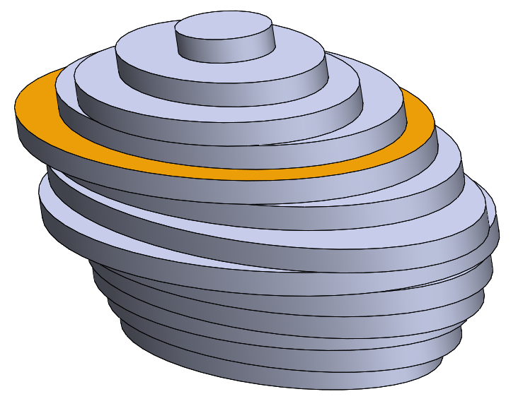
Determining Path Length
Mirror
Depth Axis
Reflected
Camera
Width
Axis
Line of Sight
Kernel approximated as stack of ellipsoid slices

Slide 18
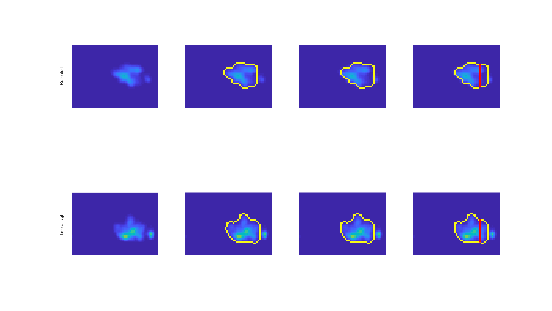
Determining Ellipse Axes
Reflected
Igniter Tip
Line of Sight
Kernel Intensity
Edge Detection
Align Tip
Ellipse Axes
Notes:
2017_12_19, DP8, {1,1}

Slide 19
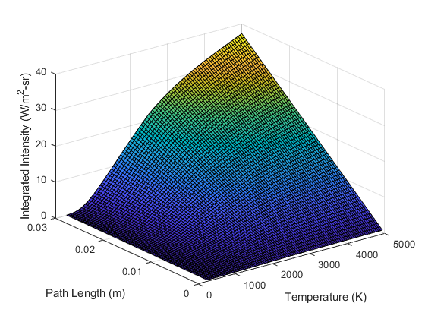
Temperature Interpolation Surface
Built using Radcal [7]
For each combination:
Composition
Pressure

Slide 20


Intensity to Temperature
Intensity image…
Temperature imge…

Slide 21
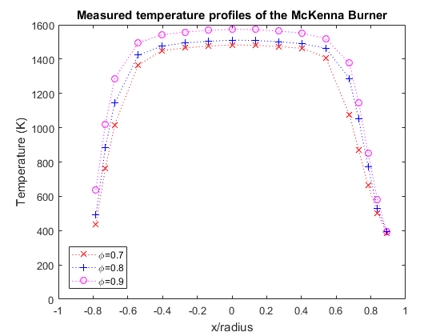
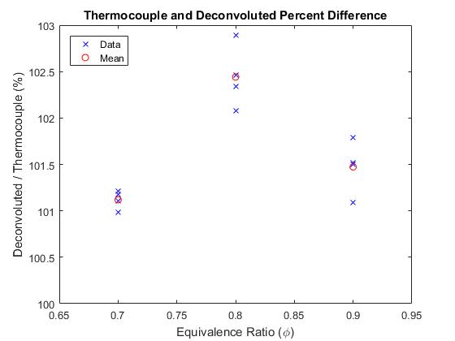
Technique Evaluation

Slide 22
Results
22

Slide 23
Kernel Intensities
1.0 atm video
0.6 atm video
0.3 atm video
At Lower Pressure:
decreased radiation emissions
shorter detectable duration
Increased rate of bifurcation
more material ablation

Slide 24
Kernel Temperatures
1.0 atm video
0.6 atm video
0.3 atm video

Slide 25
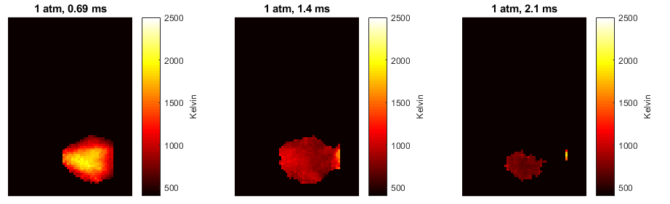

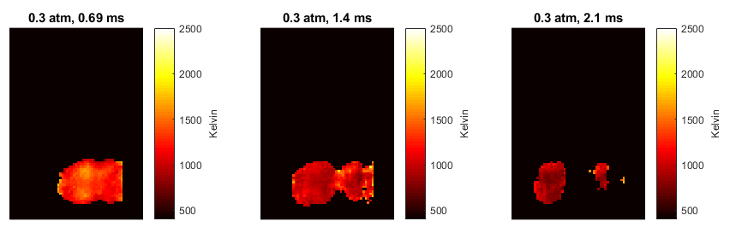
Phase Average Temperature

Slide 26
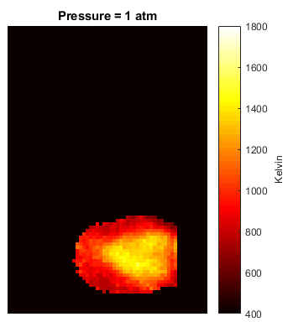


Average Temperature
At Lower Pressure:
Lower temperatures
sdsdfa

Slide 27
Summary and Conclusions
At lower pressures:
Radiation emissions are lower.
Temperatures are lower.
There is more material ablation.

Slide 28
Acknowledgements
Air Force Research Laboratory (Craig Neuroth) for use of igniter equipment
Oregon State University for funding
OSU Propulsion Laboratory (Jonathan Bonebrake and Nathan Schorn) for use of the vacuum chamber
OSU Water Resources Engineering (Chad Higgins) for use of the gas analyzer
Bryan Cmelak and Tyler Castile for help with manufacturing and data collection

Slide 29
Sources
[1] http://www.aviation-accidents.net/garuda-indonesia-boeing-b737-300-pk-gwa-flight-ga421/
[2] Sforzo, B., Lambert, A., Kim, J., Jagoda, J., Menon, S., and Seitzman, J., “Post discharge evolution of a spark igniter kernel,” Combustion and Flame, Vol. 162, No. 1, 2015, pp. 181–190.
[3] http://anko-lab.com/en/a/apparatus-for-determination-of-minimum-ignition-energy-of-a-dust-air-mixtures
[4] http://www.exschutz.net/en/basic-information-on-explosions.html
[5] http://www.itt.kit.edu/english/323.php
[6] Reinmann, R. and Akram, M., “Temporal investigation of a fast spark discharge in hemically inert gases,” Journal of Physics D: Applied Physics, Vol. 30, No. 7, 1997, pp. 1125.
[7] Grosshandler, W. L., “RADCAL: A Narrow-Band Model for Radiation Calculations in a Combustion Environment,” 1993.
[8] https://www.campbellsci.com/irgason
[9] http://www.suprasport.com/E3-Spark-Plugs_p_1520.html

